Slide 1
Lesson 11
Spring MVC Framework
Infinite Diversity Arising from Unity
Notes:
https://www.youtube.com/watch?v=YYvOGPMLVDo
MVC Song

Slide 2
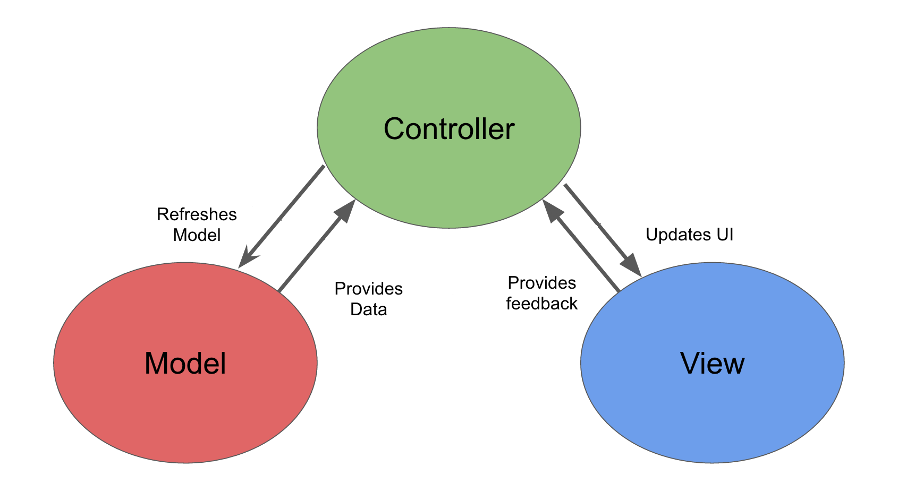
MVC Pattern
MVC Solo
See “Spring-less MVC” DEMO -- Product4aJSP
Notes:
Original SMALLTALK
Xerox Palo Alto Research Center (PARC)

Slide 3
Spring MVC
Distinct Separation of Concerns
Clearly defined interfaces for role/responsibilities “beyond” Model-View-Controller
Single Central Servlet
Manages HTTP level request/response
delegates to defined interfaces
Models integrate/communicate with views
No need for separate form objects
Views are plug and play
Controllers allowed to be HTTP agnostic

Slide 4
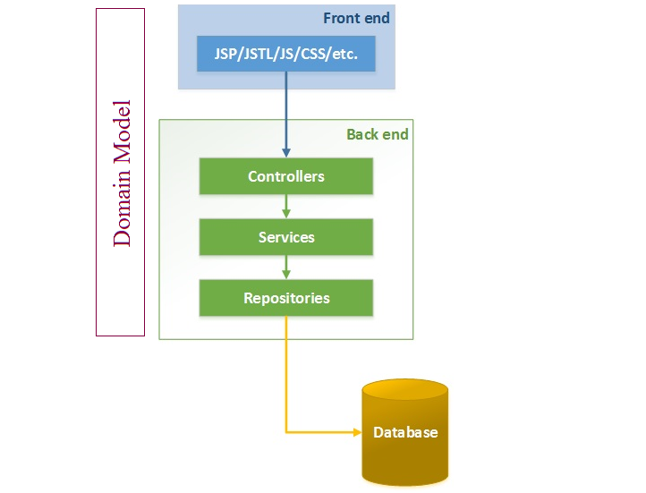
Spring N-Tier With Spring MVC
Presentation Tier
Velocity
FileMarker
ThymeLeaf
PDF
Excel
JSF
XML
JSON

Slide 5
Spring MVC DispatcherServlet
Front Controller
DispatcherServlet - "Front Controller" design pattern
Common pattern used by MVC frameworks
Single Central Servlet that dispatches requests to controllers and offers other functionality that facilitates the development of web applications.
Completely integrated with the Spring container
Able to “exploit” Spring framework features
Has a WebApplicationContext, which inherits all the beans already defined in the root WebApplicationContext.

Slide 6
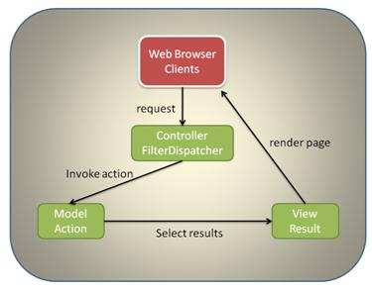
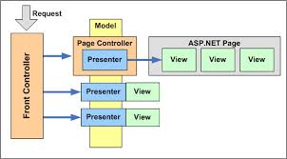
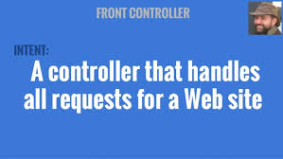
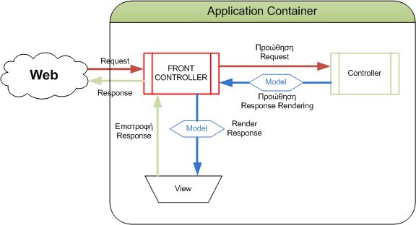
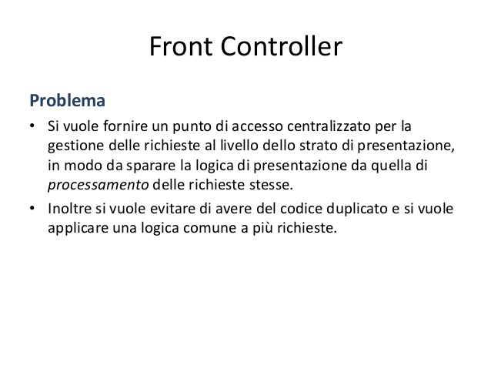
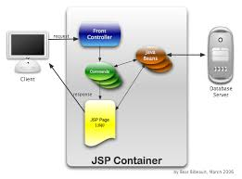
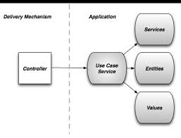

FRONT CONTROLLER

Slide 7
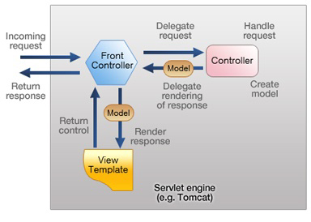
Notes:
http://docs.spring.io/spring-framework/docs/2.5.3/reference/mvc.html
The requesting processing workflow in Spring Web MVC (high level)
http://www.techzoo.org/java
Let’s Implement J2EE Application Controller Design pattern today
Tuesday, August 27, 2013

Slide 8
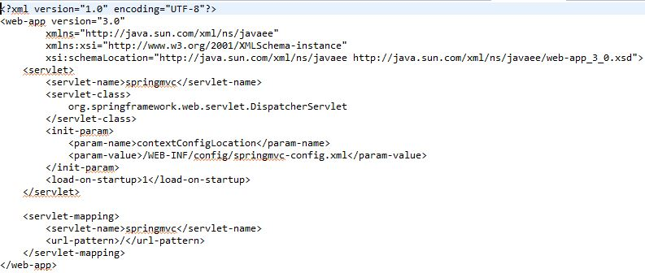
Spring MVC Front Controller Configuration

Slide 9
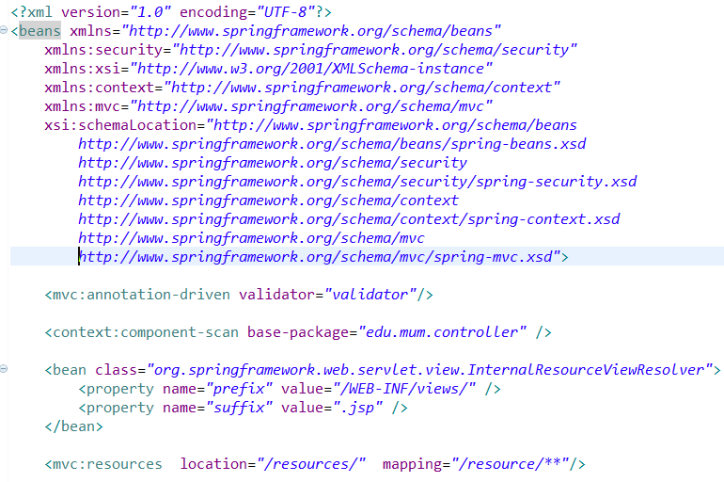
Spring MVC XML Configuration File

Slide 10
XML Configuration file – enable annotations
<context:component-scan base-package= “pkg,pkg…" >
Scans defined packages to find and register @Component-annotated classes and activate basic annotations[e.g. @Autowired] - within the current
application context
<mvc:annotation-driven/>
Enables support for specific annotations [e.g. @RequestMapping, etc.] that are required for Spring MVC to dispatch requests to @Controllers. It is based on MVC XML namespace
<tx:annotation-driven />
Enables support for specific annotations that are required for Spring Transactions @Transaction
See Product4a DEMO

Slide 11
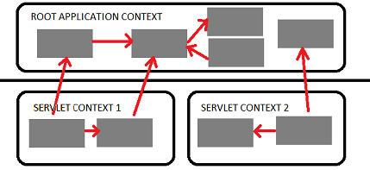

Web Application Context
Spring has multilevel application context hierarchies.
Web apps by default have two hierarchy levels, root and servlet contexts:
Presentation tier has a WebApplicationContext [Servlet Context] which inherits all the resources already defined in the root WebApplicationContext [ Services, Persistence]
Root WebApplicationContext
WebApplicationContext
Presentation tier

Slide 12
Data Binding
Automatically maps request parameters domain objects
Simplifies code by removing repetitive tasks
Built-in Data Binding handles simple String to data type conversions
HTTP request parameters [String types] are converted to model object properties of varying data types.
Does NOT handle COMPLEX data types; that requires custom formatters
Does handle complex nested relationships

Slide 13
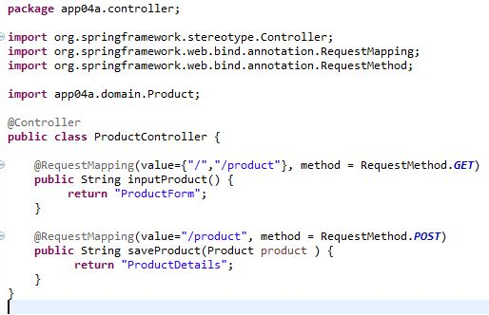
Data Binding example
Product product = new Product();
product.setName(request.getParameter(“name").trim()); product.setDescription(request.getParameter("description").trim());
try {
      price = request.getParameter(“proce").trim());
product.setPrice(Float.parseFloat(price ));
} catch (NumberFormatException e) {
}
Without Data Binding

Slide 14
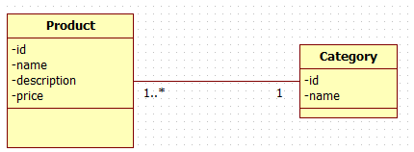
Data Binding - Relationships
<form action="product" method="post">
<legend>Add a product</legend>
<p>
<label for="category">Category </label>
<select name="category.id">
<option value="-">--Select Category--</option>
<c:forEach var="category" items="${categories}">
<option value="${category.id}" > ${category.name}</option>
</c:forEach>
</select>
<label for="name">Product Name: </label>
<input type="text" id="name" name="name" >
See SimpleMVC Demo

Slide 15
Main Point
The basic ingredients of a Spring MVC application include web pages for the view (the known), the back end domain logic and data (knower or underlying intelligence), and the Spring framework and Dispatcher Servlet and managed beans as the controller to connect the view and model. Knowledge is the wholeness of knower, known, and process of knowing.

Slide 16

Spring MVC Annotations
Handler Mapping
Spring Annotations
  @Controller
  @RequestMapping
  @ModelAttribute
  @RequestParam
  @PathVariable

Slide 17
Spring MVC @Controller
Spring implements a controller in a very abstract way, which enables you to create a wide variety of controllers.
Spring Controllers do not extend specific base classes or implement specific interfaces
They do not have direct dependencies on Servlet APIs, although you can easily configure access to Servlet facilities. [actual request, response objects, etc.]

Slide 18
Mapping Example
@Controller
@RequestMapping({"/members"})
public class MemberController {
@Autowired
private MemberService memberService;
@RequestMapping(value={"","/all"}, method = RequestMethod.GET)
public String listMembers(Model model) {
model.addAttribute("members", memberService.findAll());
return "members";
}
@RequestMapping(value="/{id}", method = RequestMethod.GET)
public String getMemberById(@PathVariable("id") Long id,Model model) {
Member member = memberService.findOne(id);
model.addAttribute("member", member);
return "member";
}
See MemberSpringMVC

Slide 19
Mapping Example [Cont.] & Validation
@RequestMapping(value = "/add", method = RequestMethod.GET)
public String getAddNewMemberForm(@ModelAttribute("newMember") Member newMember) {
return "addMember";
}
@RequestMapping(value = "/add", method = RequestMethod.POST)
public String processAddNewMemberForm( @Valid @ModelAttribute("newMember")
Member memberToBeAdded, BindingResult result) {
if(result.hasErrors()) {
return "addMember";
}
memberService.saveFull(memberToBeAdded);
return "redirect:/members";
See Member in MemberSpringMVC for Validation

Slide 20
@RequestParam
Placed on Method argument
http://localhost:8080/MemberSpringMVC/products/product?id=1
@RequestMapping("/product")
public String getProductById(Model model, @RequestParam("id") Long id) {
Product product = productService.findOne(id);
Handling multiple values [e.g., multiple selection list ]
http://localhost:8091/store/sizechoices?sizes=small&sizes=medium&sizes=large
  public String getSizes(@RequestParam(“sizes")String sizeArray[]
Notes:
NOTE: Can be used on POST parameters also – But Why?

Slide 21
@RequestMapping Template with @PathVariable
Facility to pass resource request as part of URL INSTEAD of as a @RequestParam
Conforms to RESTful service syntax
http://localhost:8080/MemberSpringMVC/members/1
@RequestMapping("/{id}")
public String getMemberById(@PathVariable("id") Long id,Model model) {
Member member = memberService.findOne(id);
@PathVariable is used in conjunction with @RequestMapping URL template.
In this case it is a means to get the category string passed in the method signature.
The @PathVariable param needs to be the same as the param in the @RequestMapping
See Member in MemberSpringMVC

Slide 22
Main Point
Annotations are metadata that allow the knowledge about the creation of an object to reside with the object itself
The self-referral nature of Transcendental Consciousness makes all our actions clearer and more powerful

Slide 23
Spring MVC Form Tag Library
Facilitates the development of JSP pages
Integrated with Spring MVC data binding features
Each tag provides support for the set of attributes of its corresponding HTML tag counterpart, making the tags familiar and intuitive to use.
Access Form Tag Library:
<%@ taglib prefix="form" uri="http://www.springframework.org/tags/form" %>
See MemberSpringMVC

Slide 24
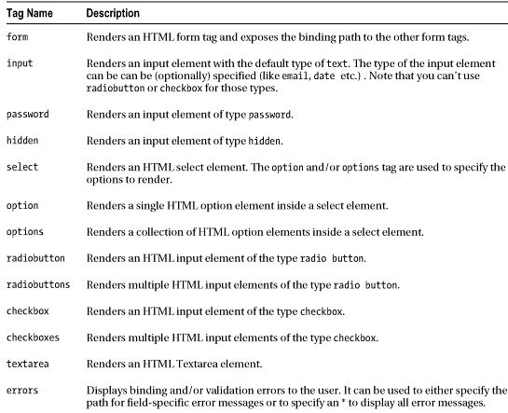
Form Tag Library

Slide 25
Form Tag
This tag renders an HTML 'form' tag and exposes a binding path to inner tags for binding. All the other tags in this library are nested tags of the form tag.
@RequestMapping(value = "/add", method = RequestMethod.GET)
public String AddProduct(@ModelAttribute("newProduct")
Product newProduct) {
<form:form modelAttribute="newProduct" action="add" method="post >
@RequestMapping(value = "/add", method = RequestMethod.POST)
public String saveProduct(@Valid @ModelAttribute("newProduct") Product productToBeAdded, BindingResult result) {

Slide 26
Form examples with HTML output
<form:input id=“name" path=“name"/>
Generated HTML:
<input id=“name" name=“name" type="text" value=""/>
When categories is a LIST
<form:select id="category" path="category.id"
items="${categories}" itemValue="id" itemLabel="name" />
Generated HTML:
<select id="category" name="category.id">
<option value="1">Computing</option>
<option value="2">Travel</option >
<option value="3">Health</option >
</select>
NOTE: path is the “binding Path” defined previously

Slide 27
General Purpose
Spring Tag Library
Not Spring MVC specific
Available to any Java Server Page used in the Spring Framework
Tags for evaluating errors, setting themes and outputting internationalized messages.
<%@ taglib prefix="spring" uri="http://www.springframework.org/tags"%>

Slide 28
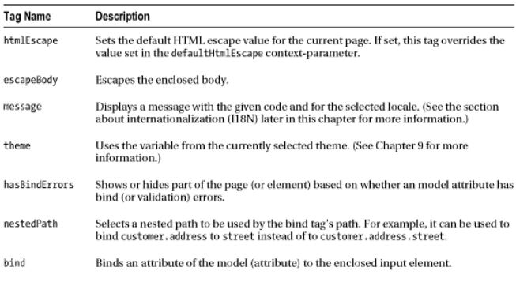
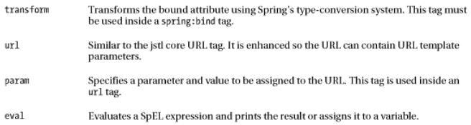
Spring Tag Library

Slide 29
Message Tag
Message tag
Internationalization support through externalization of messages
Text from MessageSource configured in DispatcherServlet
<spring:message code="greeting" text =“Hi" />
“code” isn’t set or cannot be resolved, “text” will be used as default message.
Also, the spring:message- tag, works with the locale support that comes with Spring. [ Internationalization]

Slide 30
Controller return “view”
View Resolver[s] can simplify view declaration
For example with the view resolver:
<bean id="viewResolver" class="org.springframework.web.servlet.view.InternalResourceViewResolver
<property name="prefix" value="/WEB-INF/jsp/"/>
<property name="suffix" value=".jsp"/>
</bean>
return "ProductForm";
resolves to:
/WEB-INF/jsp/ProductForm.jsp
The subsequent RequestDispatcher forward is done by the framework

Slide 31
Main Point
The Spring MVC tag library facilitates JSP development with specialized Form tags.The practice of the TM technique, by structuring the laws of nature in one’s life makes everything go more smoothly.

